Slide 1
Problem Solving & Decision making
Define it.
Practice it.
Ideas to improve it.

Slide 2
Define it: what is problem solving?
Problem Solving is process that begins with identifying causes of a situation, challenge or circumstance that is recognized to be a problem.
In problem-solving, you are concerned with defining the problem in terms of how, where, with whom, and why.*
Think about a recent problem you have had.
What is one problem you had today before you left your “home”?
Is there a challenging situation you face in a friendship?
Are there situations in your classes, projects or organizations you are a part of you recognize as a problem?
*Source: DifferenceBetween.com
Notes:
We all have to solve problems and make decisions (big and small, significant and less significant) every day of our lives.
As a student, you have to decide when and how to study; which co-curricular activities to participate in; which classes to take; when to work during the semester or not to work; and more.
When you enter your profession, you will be required to make important decisions that not only affect you but others in your organization and even the organization itself.
Developing strong problem-solving, idea generation and decision-making skills is essential.a

Slide 3
Goals and Barriers
All problems have two features in common: Goals and Barriers
Goals
Problems involve setting out to achieve some objective or desired situation and can include avoiding a situation or event.
Goals can be anything that you wish to achieve, or where you want to be.
Barriers
If there were no barriers in the way of achieving a goal, then there would be no problem. Problem solving involves overcoming the barriers or obstacles that prevent the immediate achievement of goals.
*Source: https://www.skillsyouneed.com/ips/problem-solving.html
Notes:
Example: Goals can be anything that you wish to achieve, or where you want to be. If you are hungry then your goal is probably to eat something.
A barrier to this may be that you have no food available - so you take a trip to the supermarket and buy some food, removing the barrier and thus solving the problem.

Slide 4
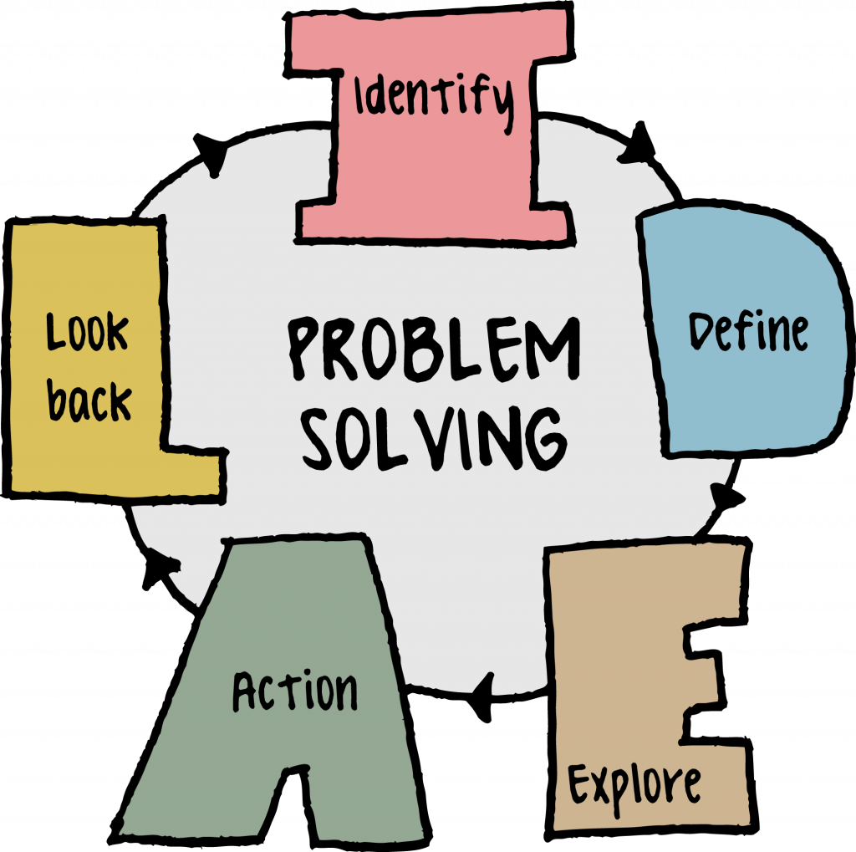
Practice it→ IDEAL
1. Identify: Realize there is a problem.
2. Define the problem.
3. Explore: What are the possible outcomes?
- What outcome do YOU want?
4. Action: Make a plan and define actionable steps will you take
5. Look back: Reflect on how you handled that problem
- What went well, what did not?
https://uta.pressbooks.pub/industrialengineeringintro/chapter/what-is-problem-solving/

Slide 5
What skills do you feel most confident in when solving problems?
Creative Thinking: More complex problems or problems that you have not experienced before will likely require a more systematic and logical approach to solve.
Researching Skills: this may be a simple Google search or a more rigorous research project.
Team Working: Many problems are best defined and solved with the input of other people.
Emotional Intelligence: the ability to recognize the emotions of yourself and others, will help guide you to an appropriate solution.
Risk Management: Solving a problem involves a certain amount of risk - this risk needs to be weighed up against not solving the problem.
Decision Making: Making a decision is an important part of the problem solving process as you will often be faced with various options and alternatives.
*Source: https://www.skillsyouneed.com/ips/problem-solving.html

